Slide 1
LOCATION BASED ALARM
TEAM:- CODE_HOUNDS
Debjyoti Mondal
Dedipya Paul
Shlok Kumar Kyal
Gowreesh Mago

Slide 2
The Basic Background:-
Time has reached the peak of importance for all of us.
We all are bounded by the immense power it holds.
But as Variable its bit exaggerated in our situation.
It’s competitor:- Distance coordinates.

Slide 3
The Problem we tried to tackle
Suppose we want a reminder just before reaching a location. Examples include packing up bags just before departing from a train, or maybe to notify our well wishers about reaching the destination.
There are various methods for it. One is to set up an alarm for a particular time. But the “projected” time may not always be a reliable variable. There may be unforeseen variations. A better variable shall be a distance. This is what is called Geo Fencing in technical terms.
Whenever you are at a predefined proximity (radius) from the destination, the alarm shall sound.
A practical application shall be an alarm that ‘wakes up’ the user exactly when required and not at the projected time in case a delay occurs.

Slide 4
Our Approach
We all are Newbies to coding with only handful of tools at our disposal. But we sure have tried our best to make whatever we can with those.
First, a user defines a path from source to destination via 5 different set of points on a 2-D coordinate system. Things shall definitely turn out to be better if we could use APIs for providing current coordinates of the user. In future we shall be implementing that for sure. For now we have the user to define the route.
The user is on a ‘virtual ’ journey from the source to the destination, with a variable velocity, inline with the relative position vector between two consecutive position coordinates, predefined by the user.
A ‘circular fence’ is created at the destination which on crossing shall trigger the alarm to wake up the user. The purpose is hence served.

Slide 5
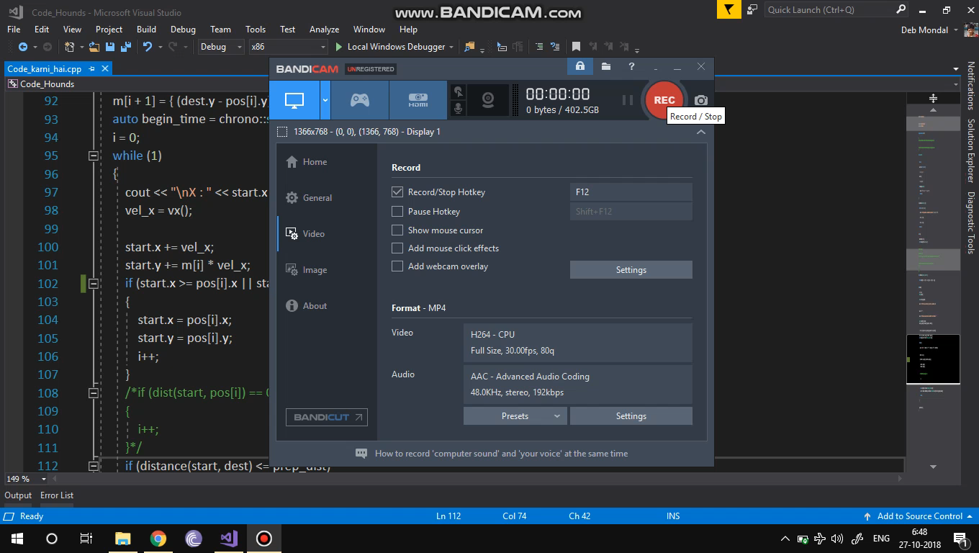

Slide 6
What we plan to add further
Given some time to learn other basics, we shall be able to make an android application for the same.
The coordinates can be tracked by popular map service providers like Bing maps, Google maps using APIs. This shall be of a much better practical utility than our present project.

Slide 7
Thanks Concetto (_/\_)
We all are grateful to the team Concetto for providing us an opportunity to learn new stuff which we is sure to help us increase our learning curve. It has sure been a great experience.

